Slide 1

Stock Price Prediction with LSTMs
Predict stock prices using Long Short-Term Memory networks. Utilize time-series data for better financial forecasting. Enhance investment strategies with advanced machine learning techniques. With the rise of deep learning techniques, models such as Long Short-Term Memory (LSTM) networks have emerged as powerful tools for time-series forecasting.
by Sakshi Tripathi
Sandali Srivastava

Slide 2
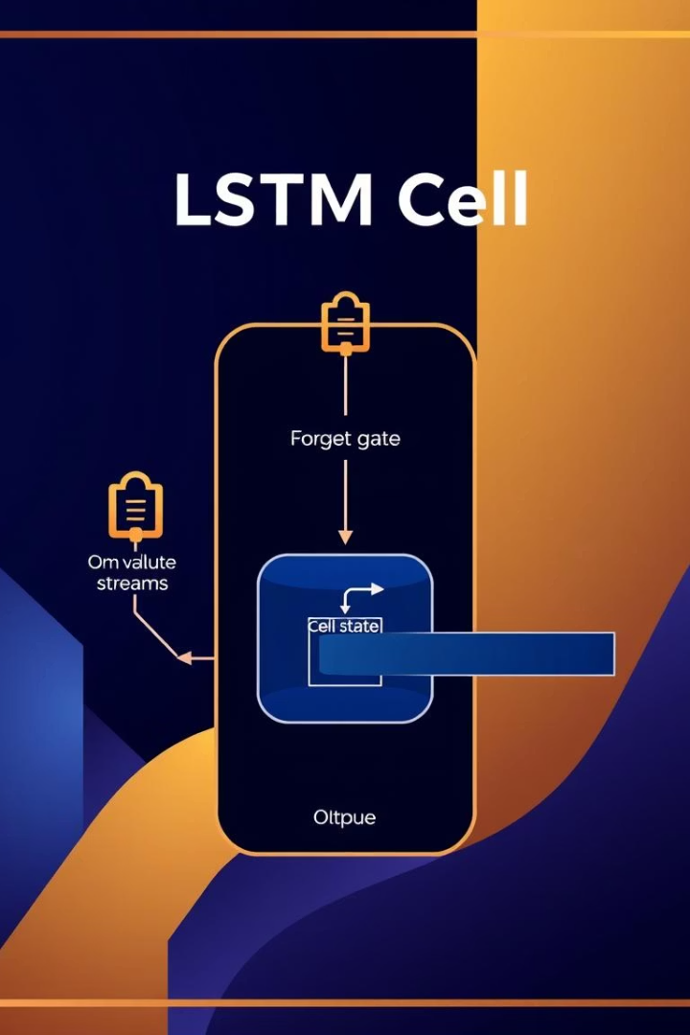
Understanding LSTMs
LSTMs overcome the limits of traditional RNNs by managing long-term dependencies.
In the context of stock market prediction, LSTMs can learn and remember relevant trends, fluctuations, and seasonal patterns in historical data. This makes them an ideal choice for building predictive models that attempt to forecast future stock prices based on past behaviors.
LSTM (Long Short-Term Memory) is a special type of neural network designed to work with sequence data like time series.
LSTM uses memory cells that can keep or forget information through gates: input gate, forget gate, and output gate.
The input gate controls what new information enters the memory.
The forget gate decides which information to discard from memory.
The output gate determines what information is passed on to the next step.

Slide 3


Workflow Overview
Stock data includes OHLCV features from 2015 to 2023 for AAPL. Clean data by handling missing values and outliers. Scale features using normalization techniques. Split data into training, validation, and testing sets.
Data Collection
Data Preprocessing
Historical stock data is collected from reliable financial sources such as Yahoo Finance, Google Finance, or APIs like Alpha Vantage.
Preprocessing involves cleaning the data, normalizing it (usually using Min-Max scaling), and converting the time-series into a supervised learning format using a sliding window approach.
Validation
Prediction
Validation data is used to monitor the model's performance and prevent overfitting through techniques like early stopping.
The predicted values are compared against the actual stock prices to visually and numerically evaluate performance.

Slide 4


Performance
The performance of the LSTM model in stock price prediction is evaluated by comparing its predicted outputs against the actual stock prices. A good-performing model should be able to closely follow the real market trends and produce predictions with minimal deviation.
Model Performance
Evaluating Accuracy and Reliability of Stock Price Predictions
Performance Evaluation
Measuring How Well the LSTM Predicts Stock Prices
Prediction Performance
Assessing the Accuracy of the LSTM Model in Forecasting Stocks
LSTM Model Performance
Analysis of Prediction Accuracy and Generalization

Slide 5
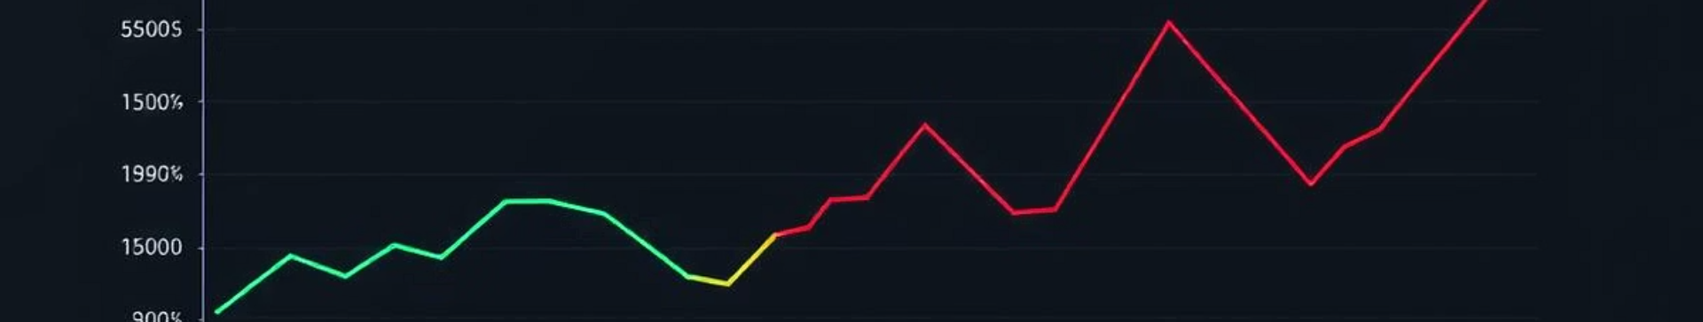

Prediction Result
The trained LSTM model predicts future stock prices with strong accuracy. Visualizations show predicted vs actual price movements. The model captures trend and volatility well over test data.
1
The predicted stock prices closely follow the trend of the actual prices over time.
2
Responsive to sudden market changes within limits.
3
Demonstrates effective generalization to unseen data.
Minor delays or lag in prediction may occur during sudden market shifts.
Prediction accuracy depends on the quality and quantity of historical data.
The model captures key market movements such as rises and falls.
The model performs better with longer training and properly tuned parameters
Minor delays or lag in prediction may occur during sudden market shifts.

Slide 6
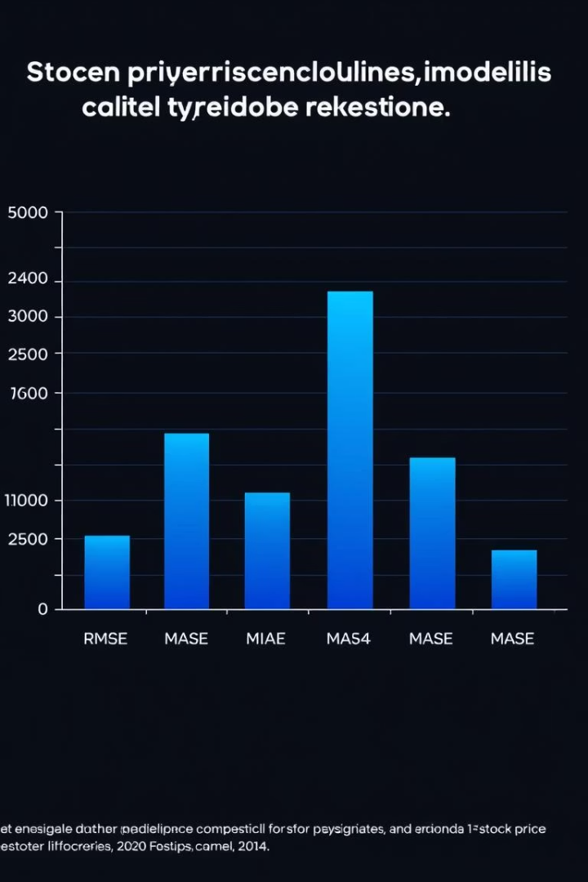
LSTM Model Architecture
The LSTM model architecture for stock price prediction consists of the following main components:
Input Layer
Takes sequences of past stock prices (e.g., last 60 days) as input.
Data is usually reshaped into 3D format: [samples, time steps, features].
LSTM Layers
One or more LSTM layers process the sequential data.
These layers have memory cells that remember important patterns over time.
Dropout Layers
Added after LSTM layers to prevent overfitting.
Randomly disables some neurons during training to improve generalization.
Dense (Fully Connected) Layer
The final layer that outputs the predicted stock price.
It combines information from the LSTM layers to generate a single value.
Output
A single value representing the predicted stock price for the next time step.

Slide 7




Tools and Implementation
Python libraries like TensorFlow, Keras, scikit-learn, and pandas facilitate LSTM modeling. yfinance provides historical data. Visualization leverages matplotlib. Simple code structure helps define LSTM models cleanly in Keras.
Python: Primary programming language for implementation.
NumPy & Pandas: For data preprocessing and manipulation.
Matplotlib & Seaborn: For data visualization and plotting prediction results.
Scikit-learn: For data splitting, scaling, and evaluation metrics

Slide 8


Limitations
LSTMs risk overfitting without enough data or regularization. Market volatility limits prediction certainty. Data quality and feature engineering, including technical indicators, improve model reliability but can't eliminate risk.
Overfitting Risks
Data Quality
Need regularization and sufficient data volume.
Accurate historical data is essential.
Market Volatility
Sudden changes challenge prediction accuracy.

Slide 9





Future Directions
LSTMs are powerful but need ongoing advances. Integrating sentiment analysis and news data could enhance predictions. Continued tuning and hybrid models may improve robustness and forecasting power.
Data Tuning
Hybrid Models
1
Continuous preprocessing improvements
2
Combining LSTMs with other algorithms
4
Broader Validation
Sentiment Analysis
3
Robust testing in volatile markets
Using news and social media data

